Slide 1


AI/ML Session - 2

Slide 2
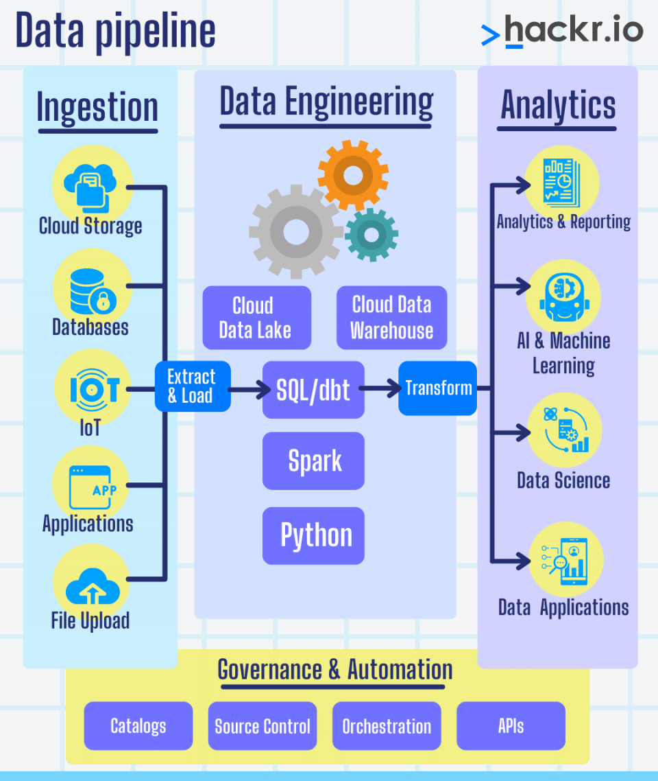
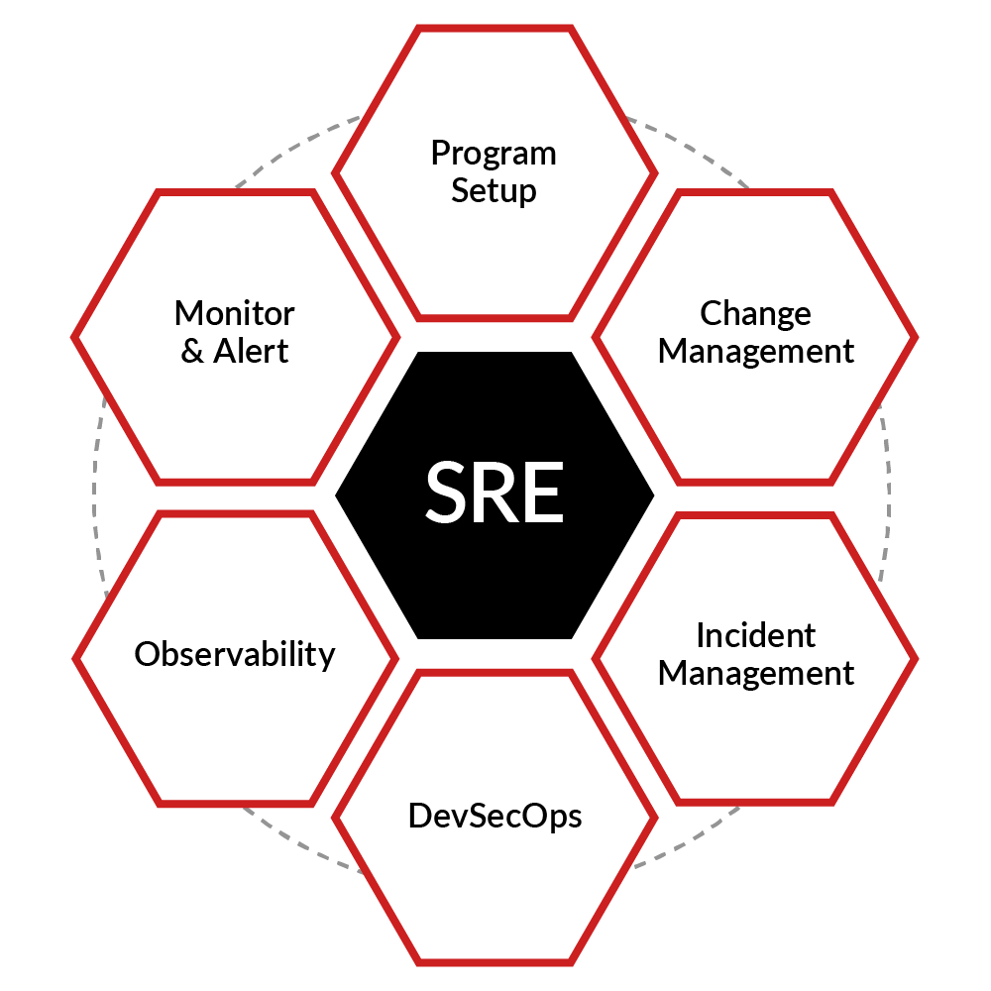
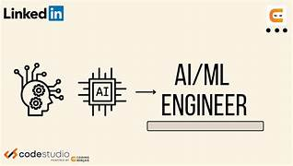

Slide 3
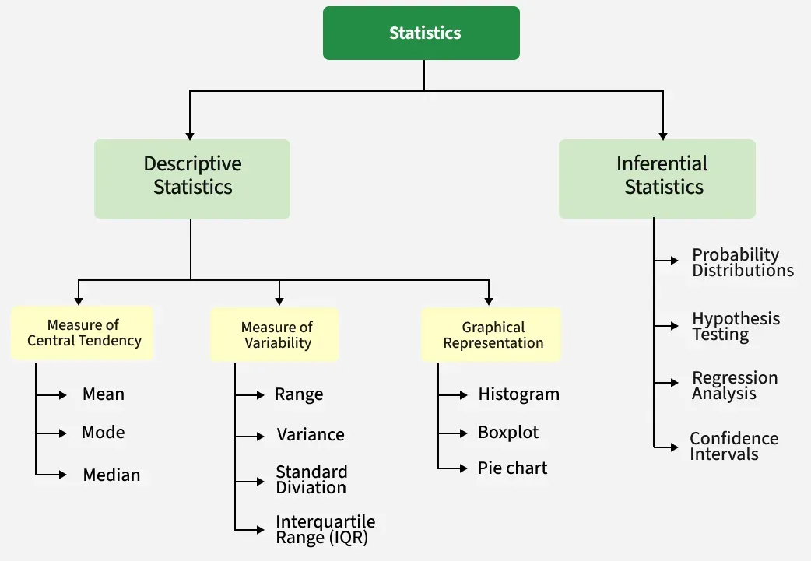
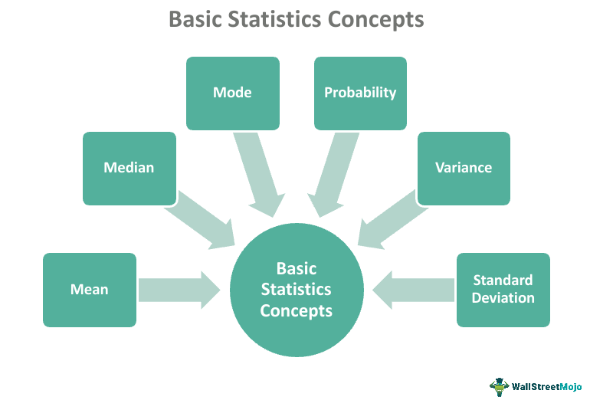
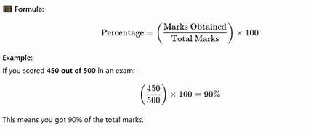
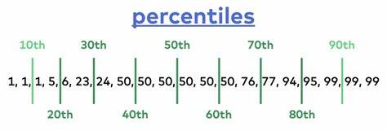

Slide 4
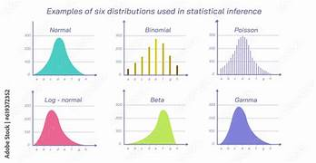
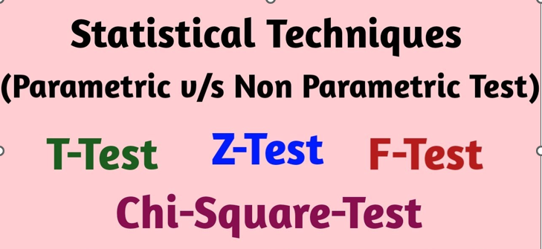

Slide 5
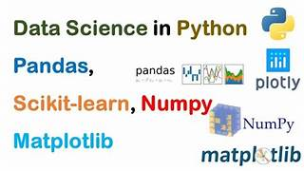
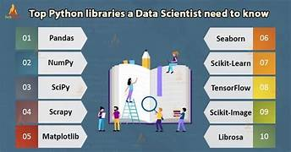



Slide 6
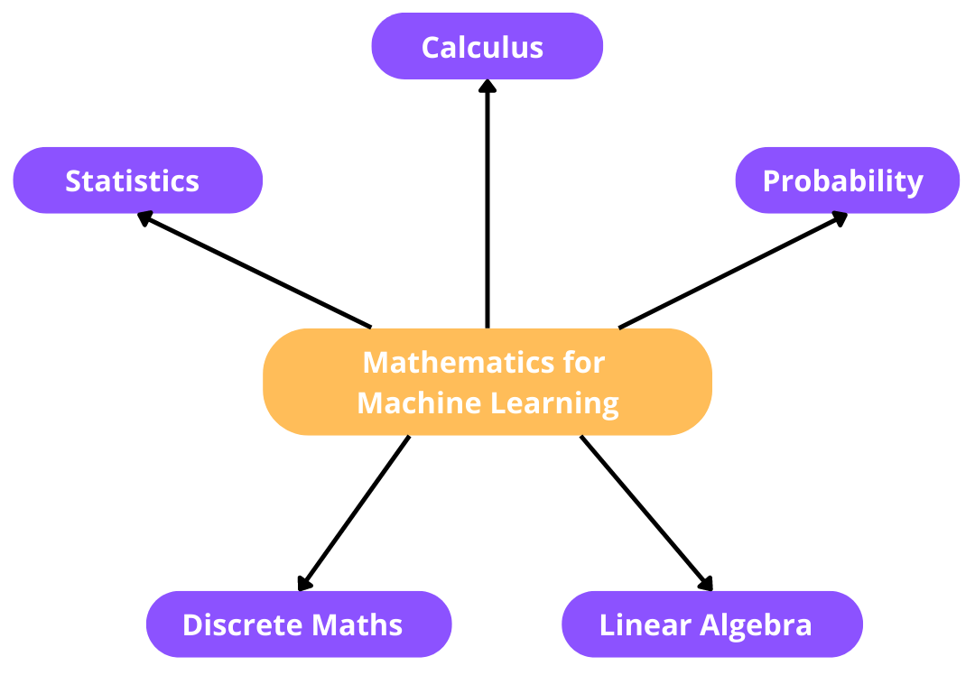
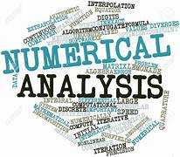

Slide 7
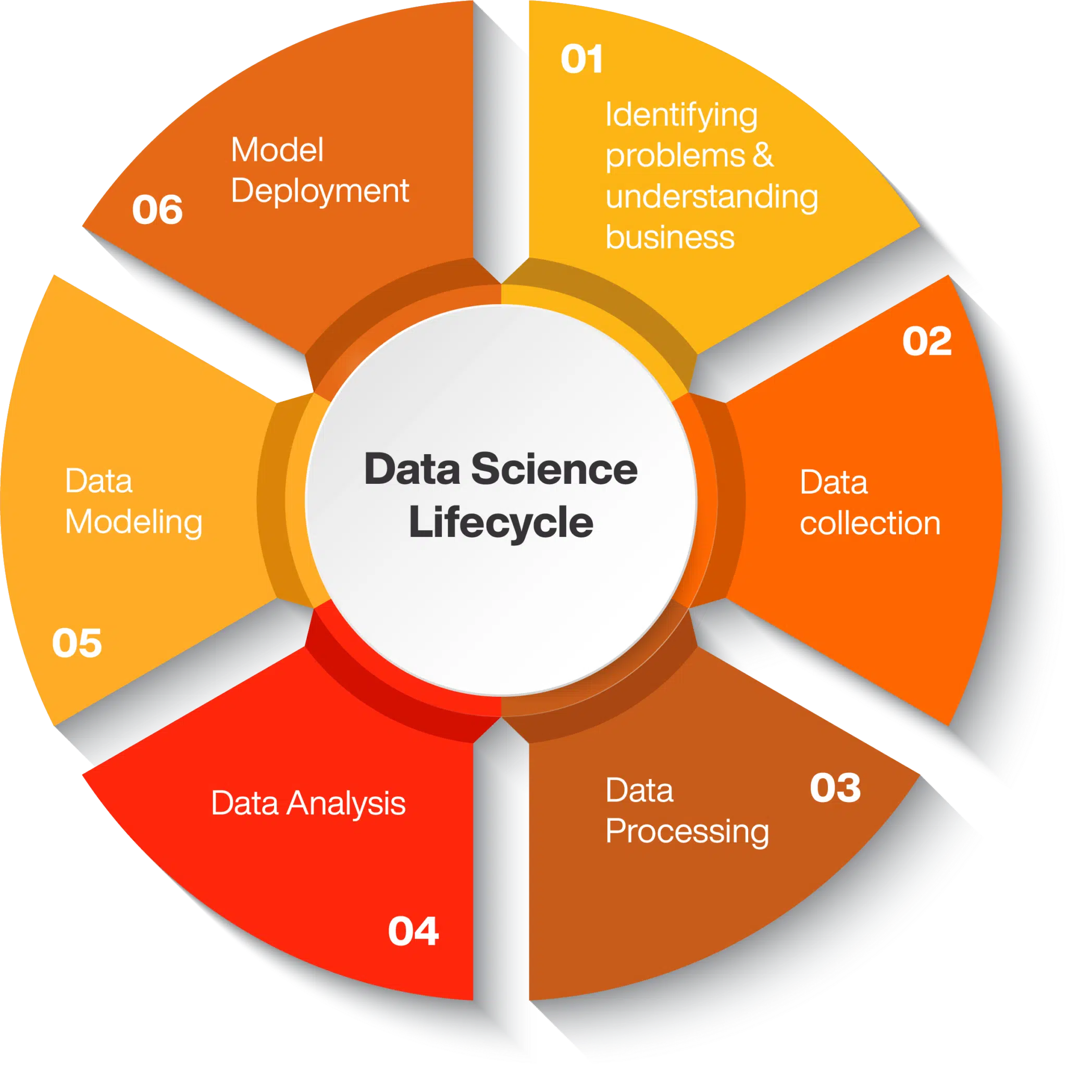
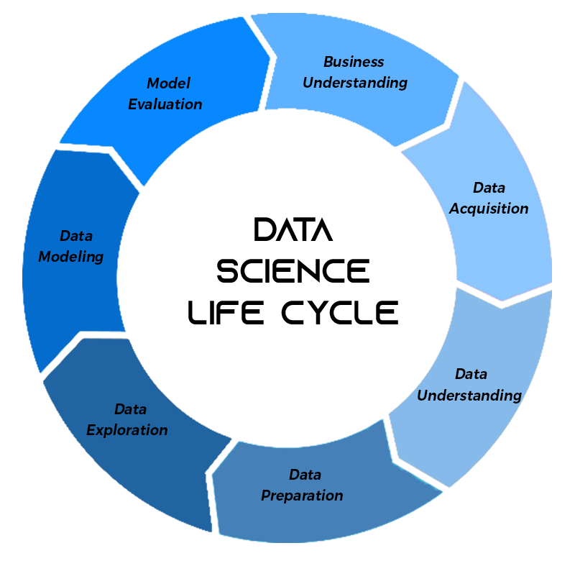

Slide 8
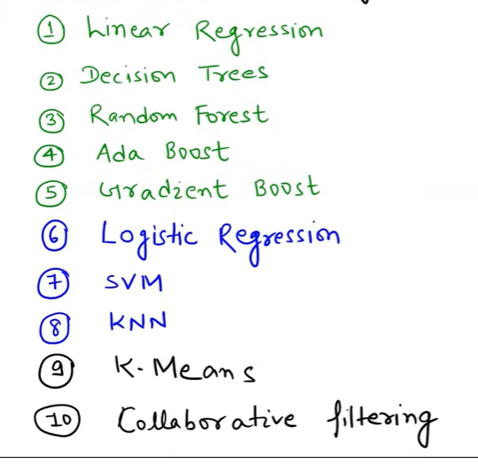
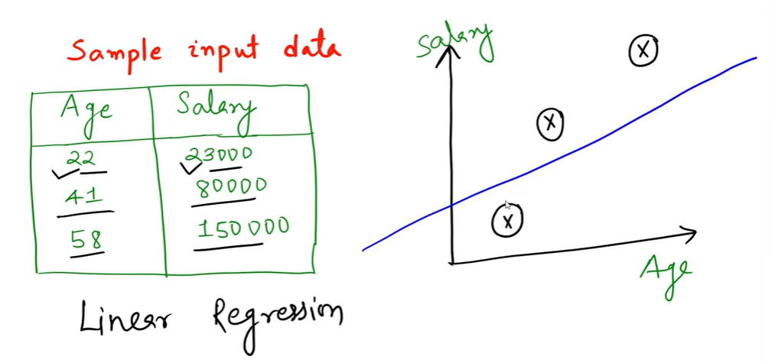
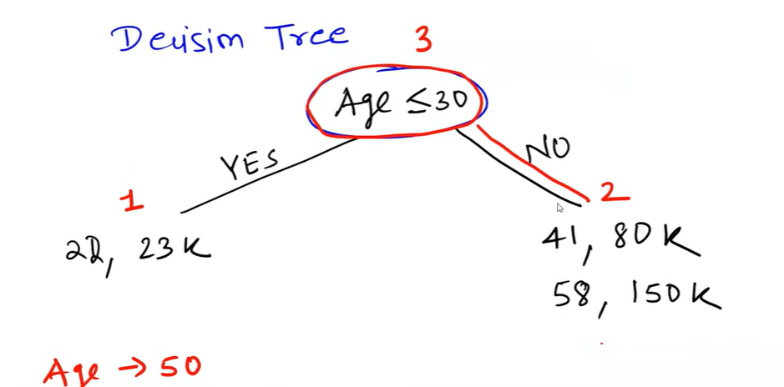

Slide 9
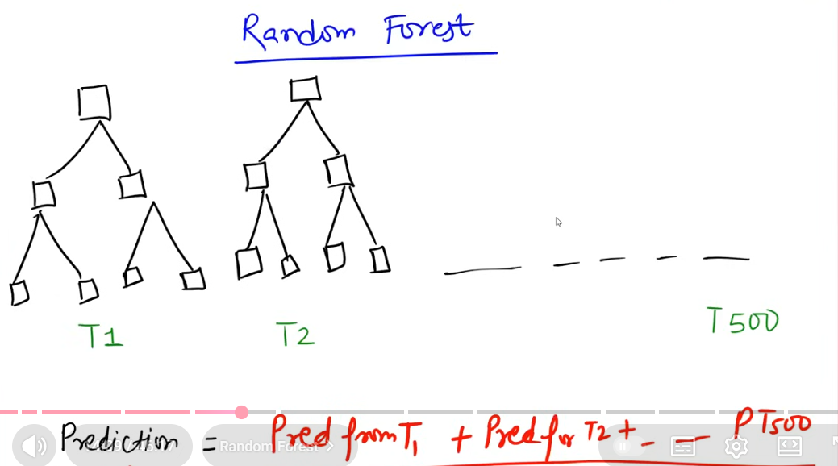
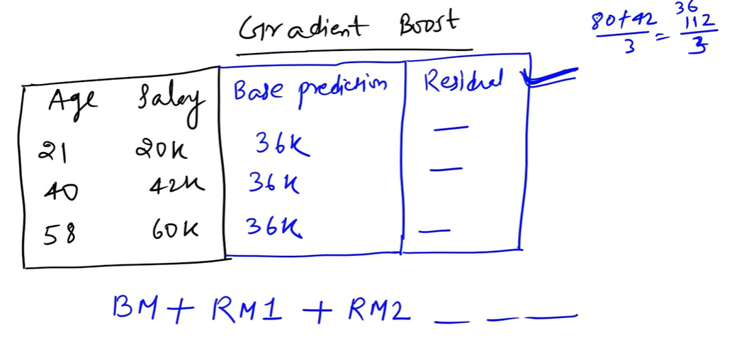
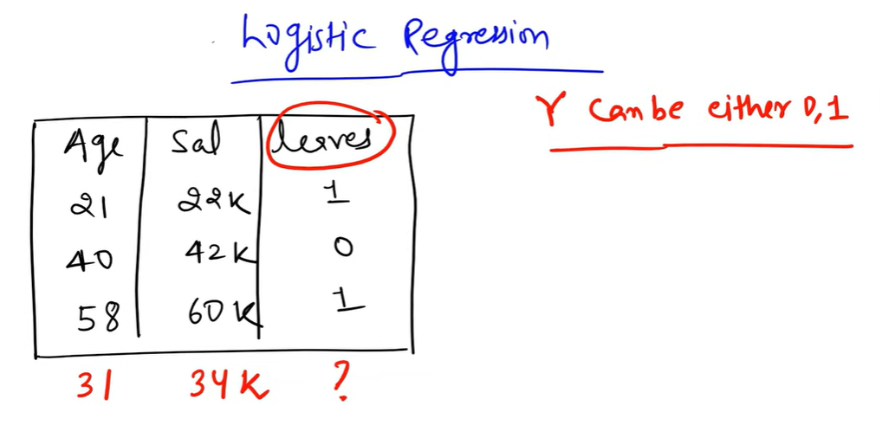
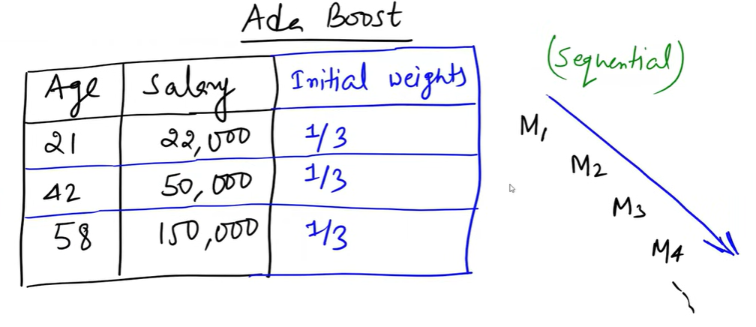

Slide 10
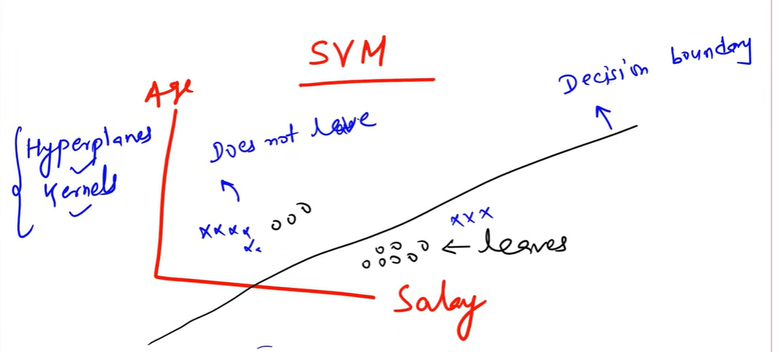
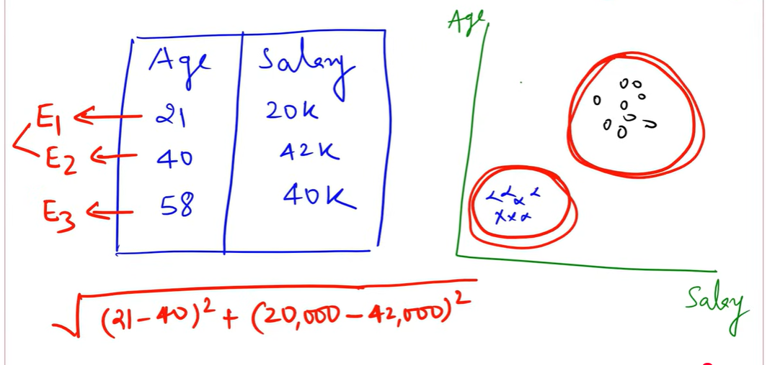
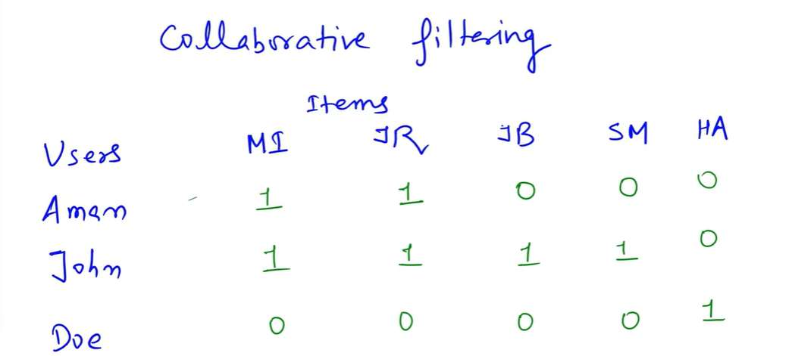

Slide 11
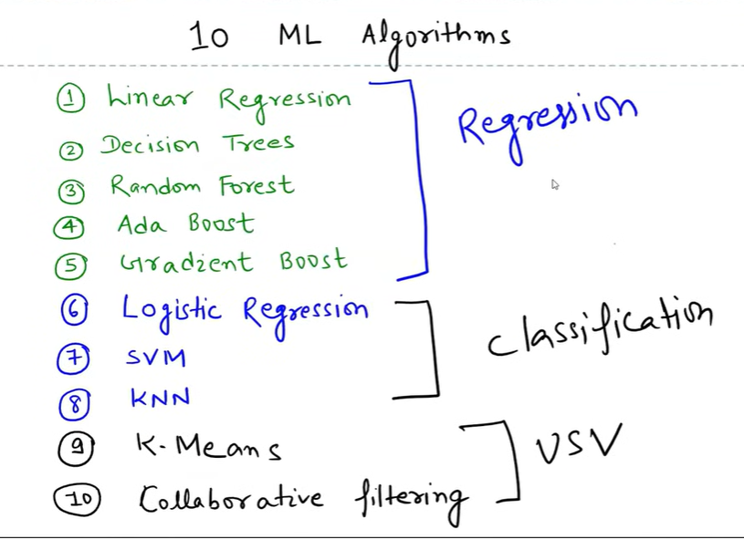

Slide 12
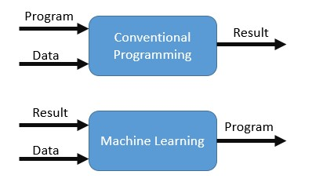
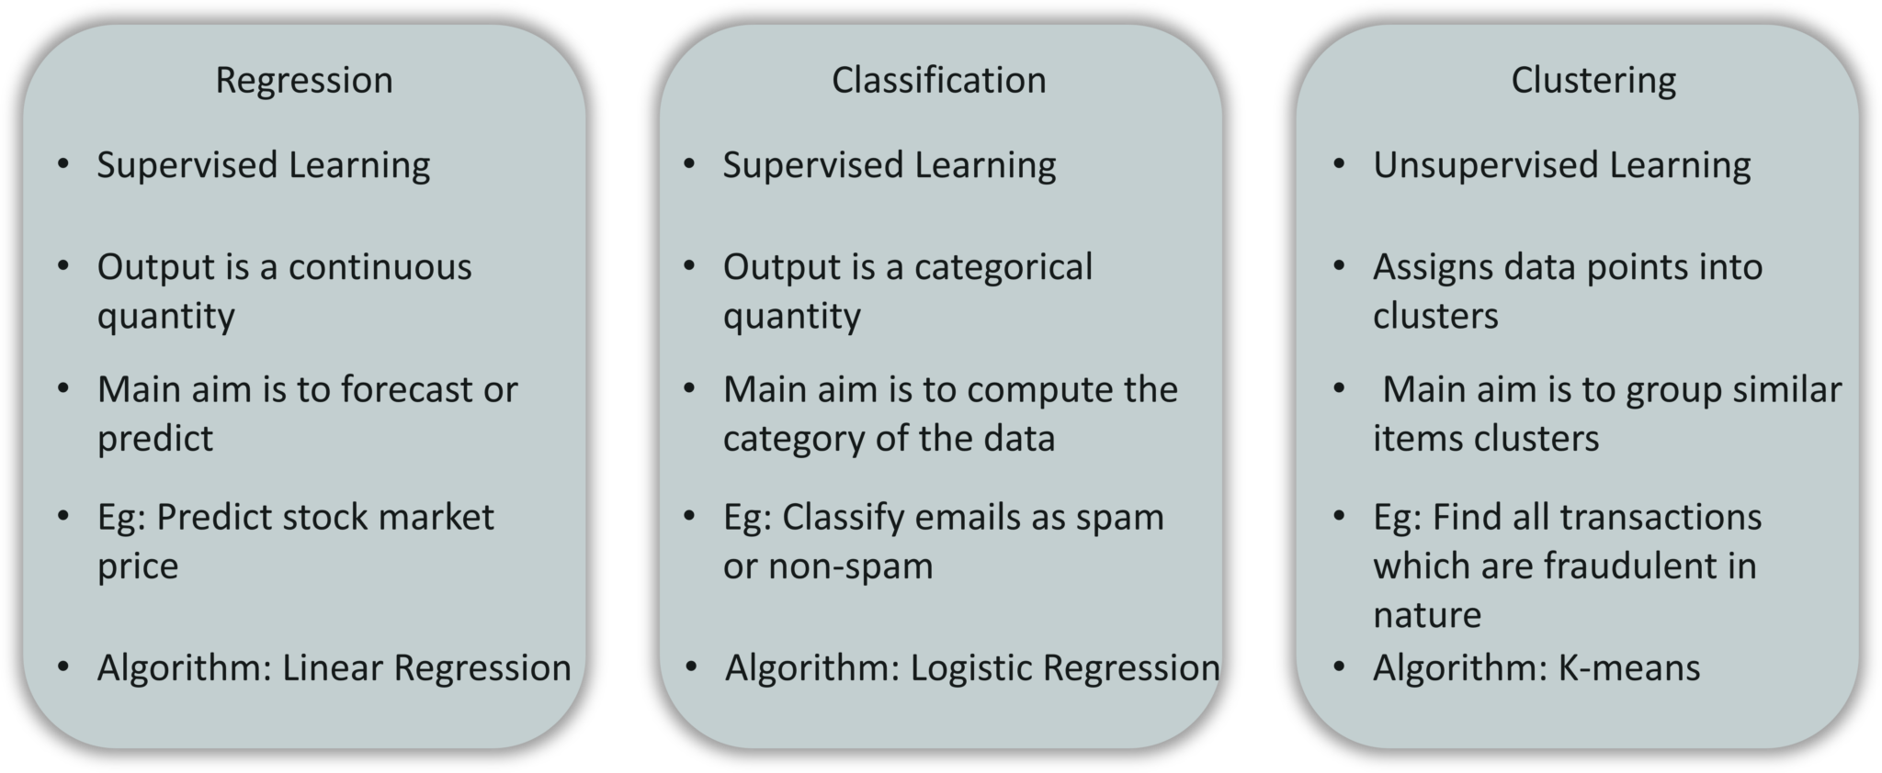
Conventional Programming Vs Machine Learning
Category | Business Problem | Description | Output Type
Classification | Customer Churn Prediction | Identify which customers are likely to stop using the service. | Churn / Not Churn
Classification | Fraud Detection | Detect fraudulent financial transactions. | Fraud / Not Fraud
Regression | Sales Forecasting (per item) | Predict sales numbers for a particular product. | Continuous Value
Regression | House Price Prediction | Estimate price based on features. | Continuous Value
Clustering | Customer Segmentation | Group customers based on behavior for marketing. | Cluster Labels
Clustering | Product Grouping | Group similar products for recommendation systems. | Cluster Labels
Time Series | Monthly Revenue Forecasting | Predict future revenue based on historical data. | Time-Indexed Values

Slide 13


Slide 14
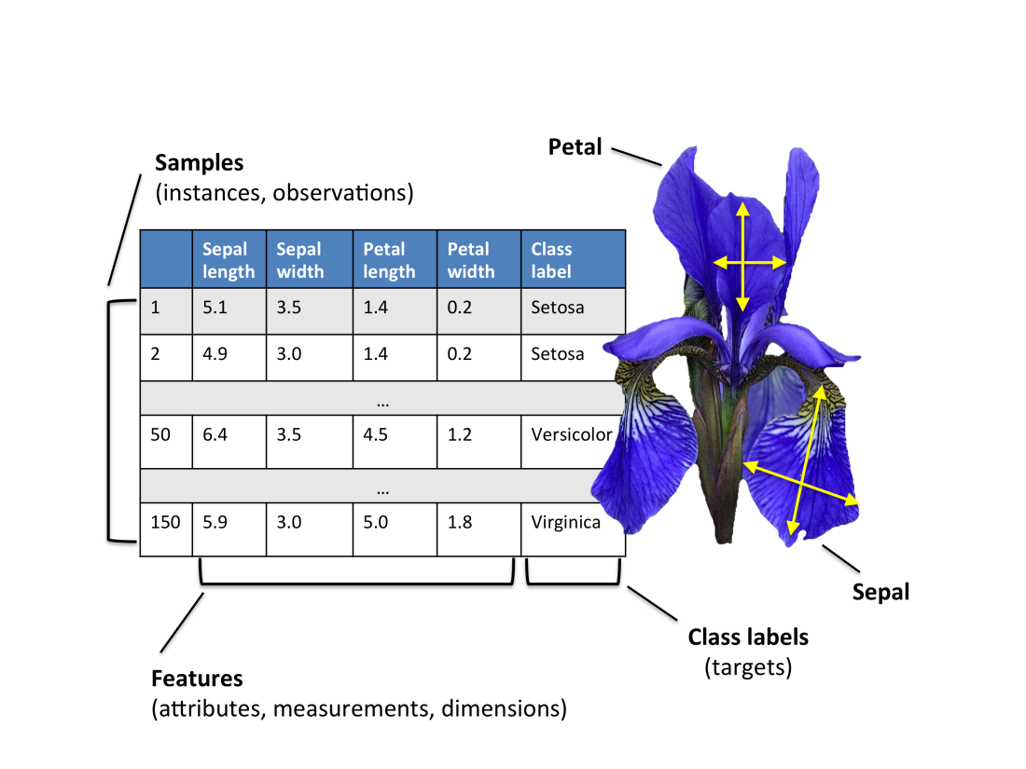
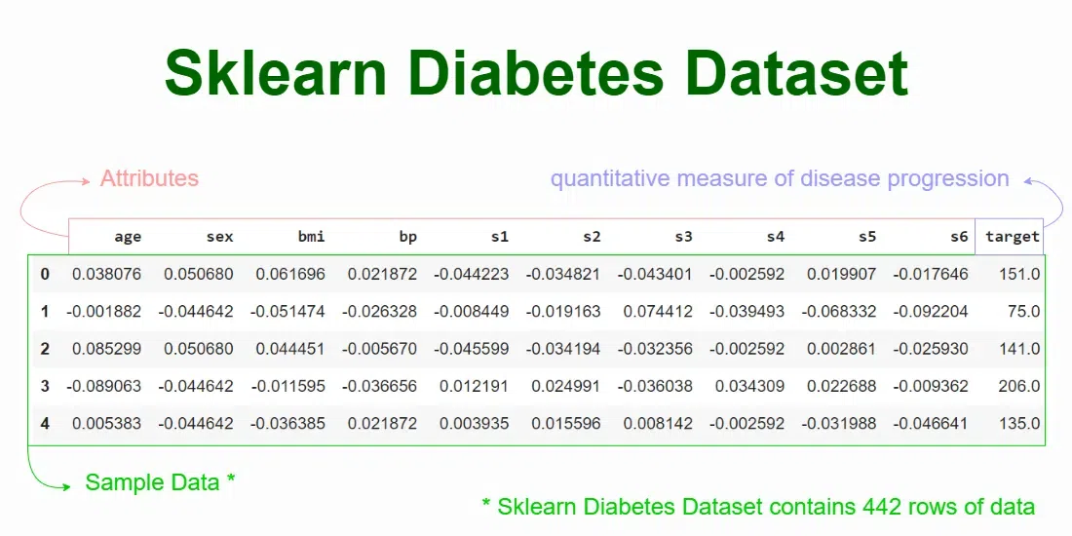
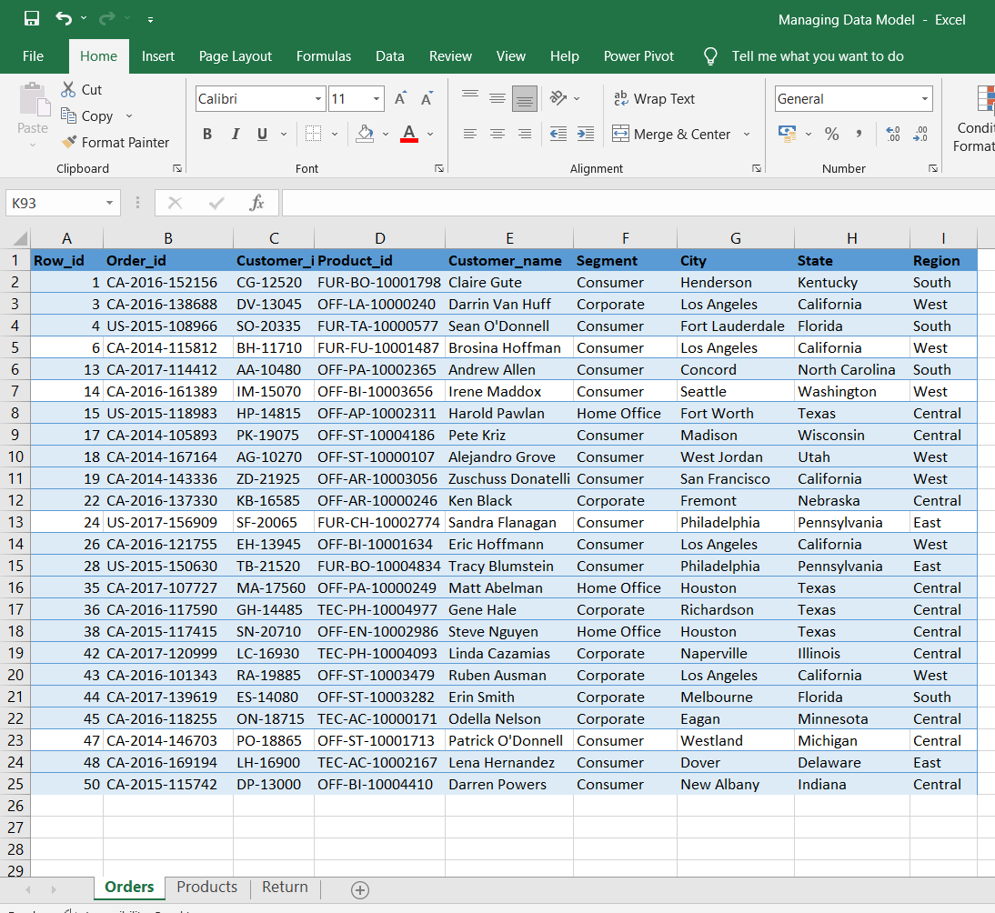
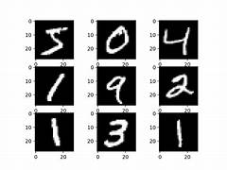

Slide 15
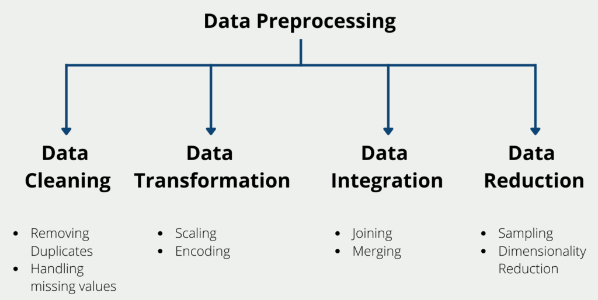
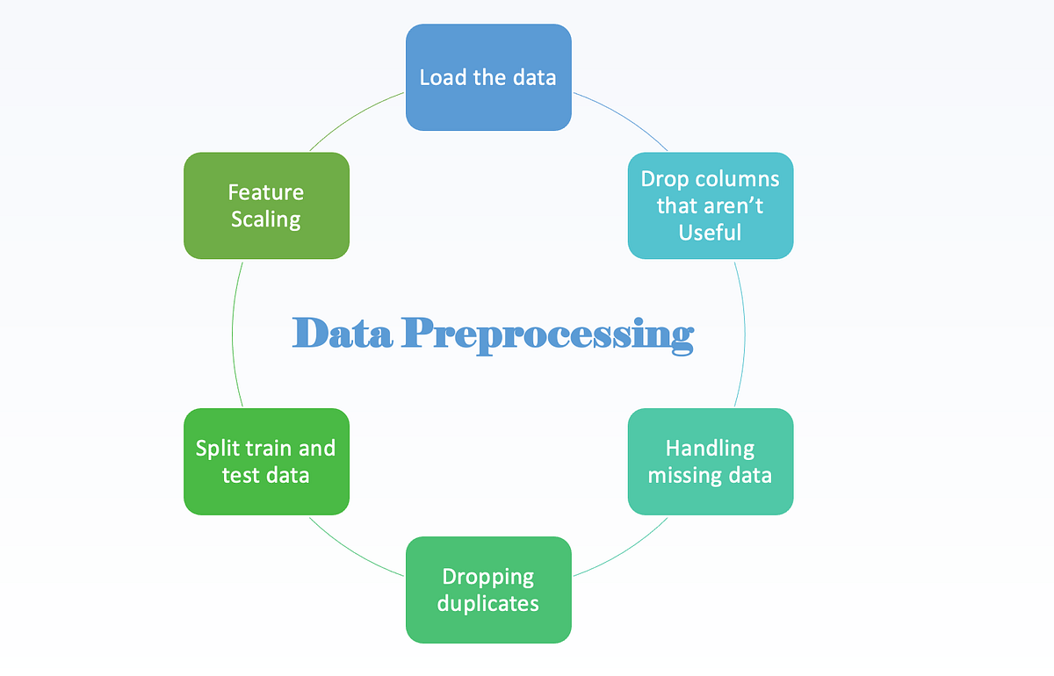

Slide 16
Steps 1–5 | Steps 6–9
Basic Inspection • Load dataset • Check shape & data types • Summary statistics • Identify issues (nulls, outliers, imbalance) | 6. Transformations • Log transform • Square-root transform • Box-Cox / Yeo-Johnson • Feature engineering
2. Fill the Null Values • Mean/Median/Mode • Forward/Backward fill • KNN/Model imputation | 7. Categorical → Numerical • One-hot encoding • Label encoding • Target encoding • Frequency encoding
3. Remove Outliers • IQR method • Z-Score method • Boxplot & visualization | 8. Standardization / Normalization • StandardScaler • MinMaxScaler • RobustScaler
4. Balance the Dataset • Oversampling (SMOTE) • Undersampling • Class weights | 9. Train / Test Split • 70/30 or 80/20 split • Stratified split for classification
5. Visualization • Histogram, boxplot • Scatterplot, pairplot • Correlation heatmap | —

Slide 17
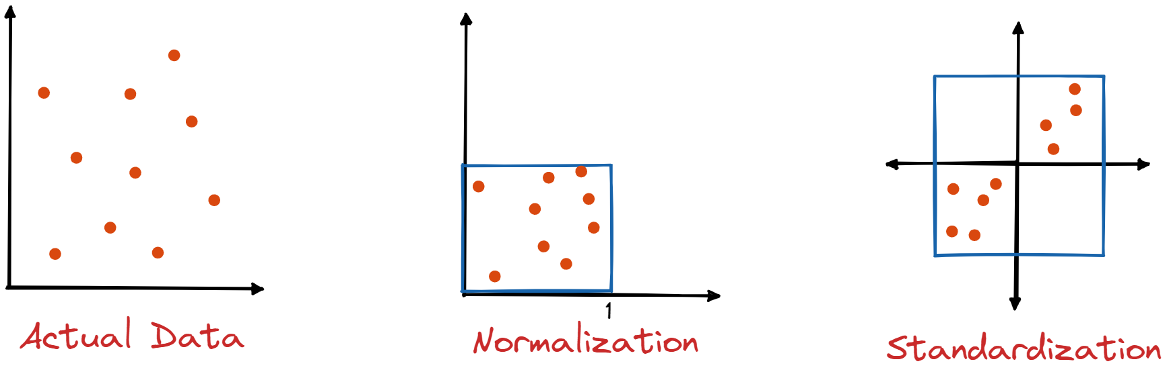
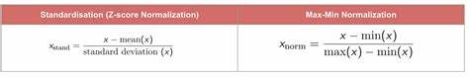

Slide 18
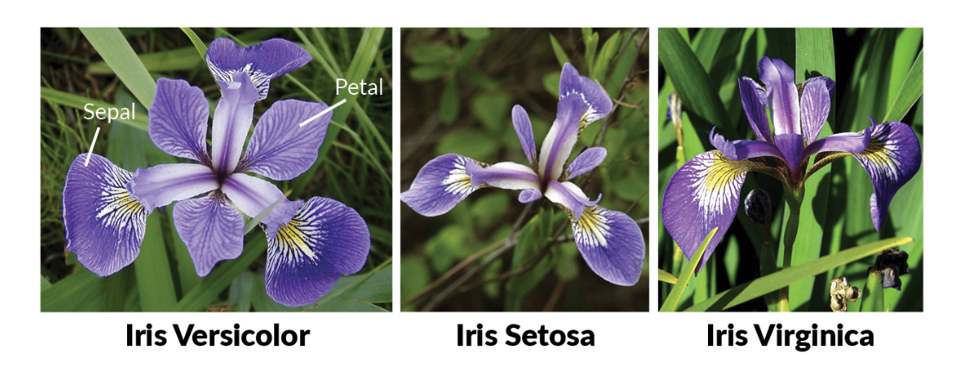
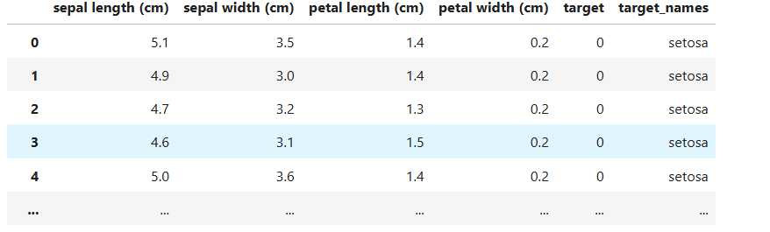
https://github.com/alexvatti/full-stack-data-science/blob/main/Internship-Exercises/ML-Internship/Classification/Iris-Flower-Classification/Iris_Flowers_Classification.ipynb

Slide 19

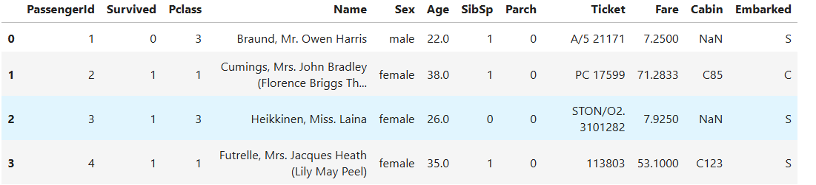
https://github.com/alexvatti/full-stack-data-science/blob/main/Internship-Exercises/ML-Internship/Classification/Titanic-Survived-Classifcation/Titanic_survival_prediction.ipynb

